Slide 1
Case examples to present
May 2018

Slide 2
Dubai Real Estate
xxx
Presentation
Asia
Europe
US
Africa
Middle East
Request
The project’s objective was to deliver a forecasting method of Dubai real estate market and compare “The Sustainable City” to its direct competitors.
Main challenges
Performing a relevant clustering and analysis of Dubai’s real estate projects, with 1M rows over 15 years.
Identifying time related trends in the market
Estimate the price of any real estate asset located in Dubai with a precision emphasis.
Dubai doesn’t provide any detailed socio-demographic data; therefore, external features are only USD index, Dubai stock market index, oil&gaz index and AED Index.
Infomineo’s approach
Data cleaning, Data Vizualisation, feature engineering.
Using K-means clustering with elbow approach to determine the cluster where The Sustainable City is.
Perform statistical analysis of time series predictions for the TSC and its direct competitors.
Compute and fine tune time series algorithms : NPTS, Simple feed forward, ARIMA, SARIMAX, seasonal trends, Transformer …
Predict the price of any asset through Machine learning algorithms : tree based, neuronal networks, regressions …
Deliverable
A web-app for data visualization, mapping and price-prediction tools
A presentation to introduce the application and detail our work and our assumptions

Slide 3
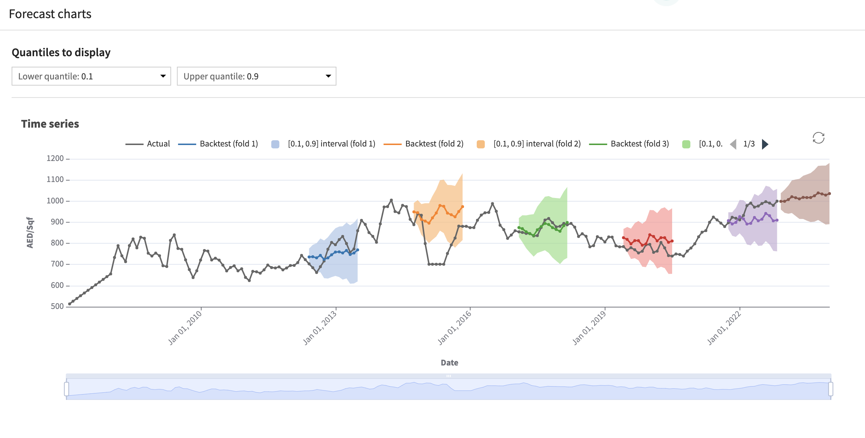
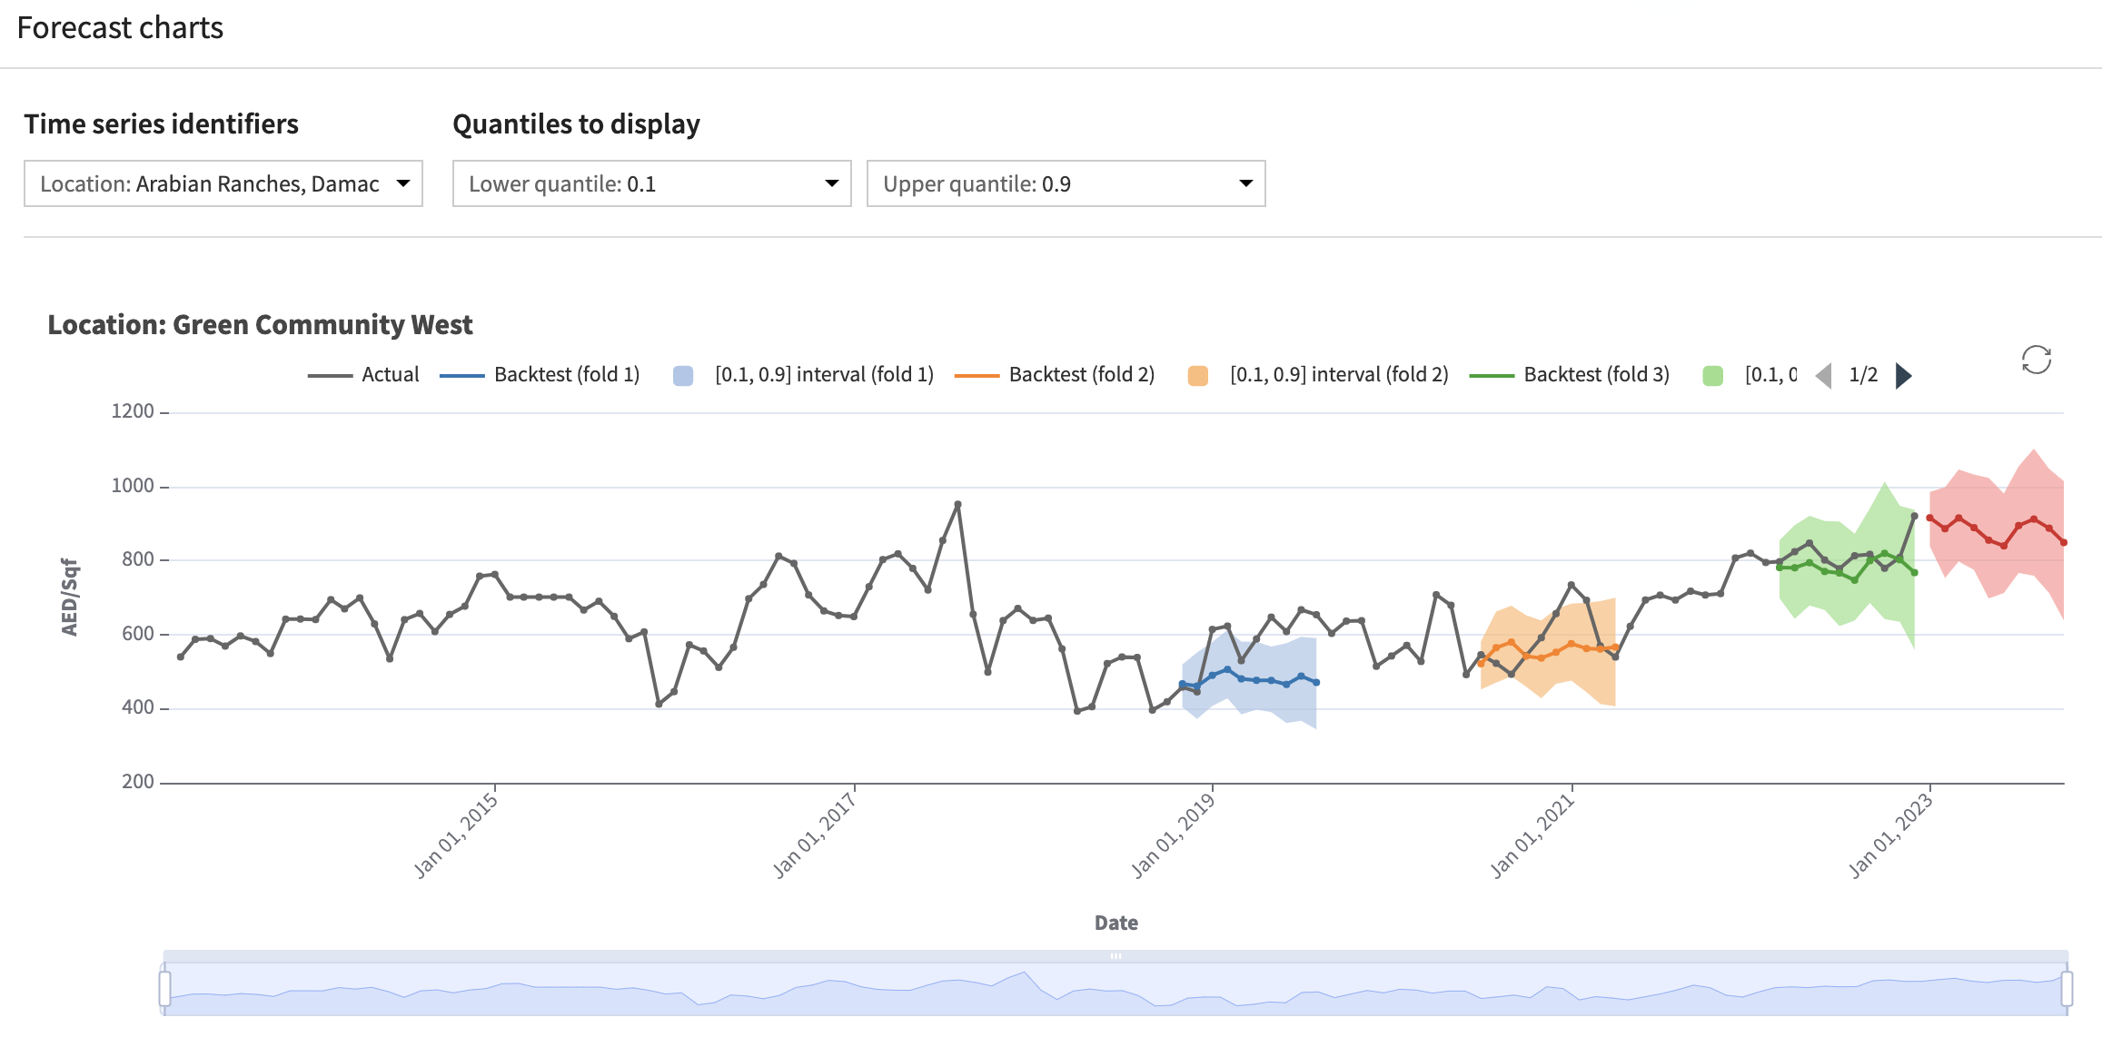
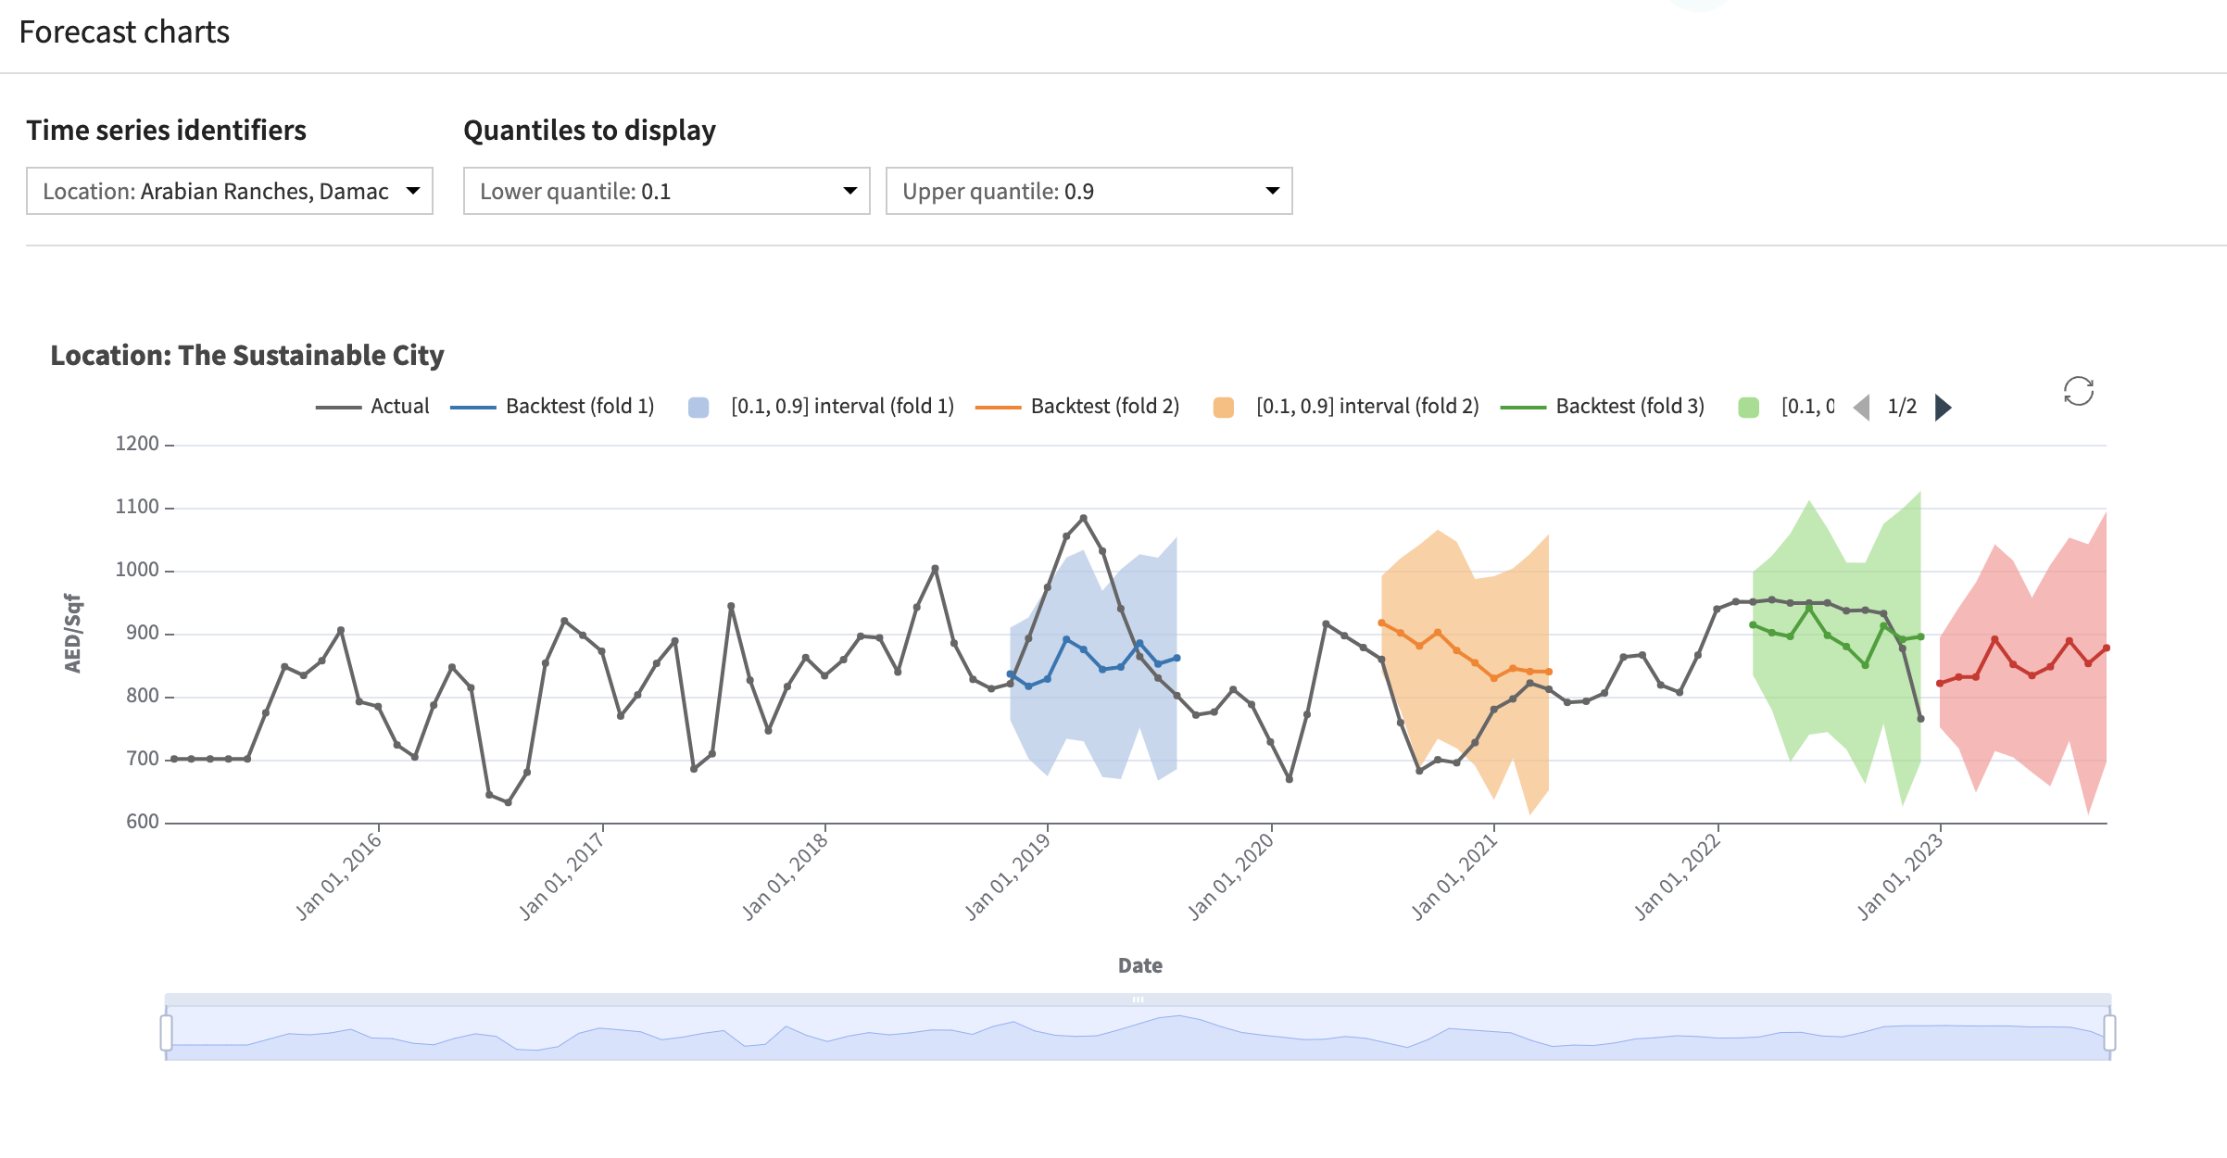
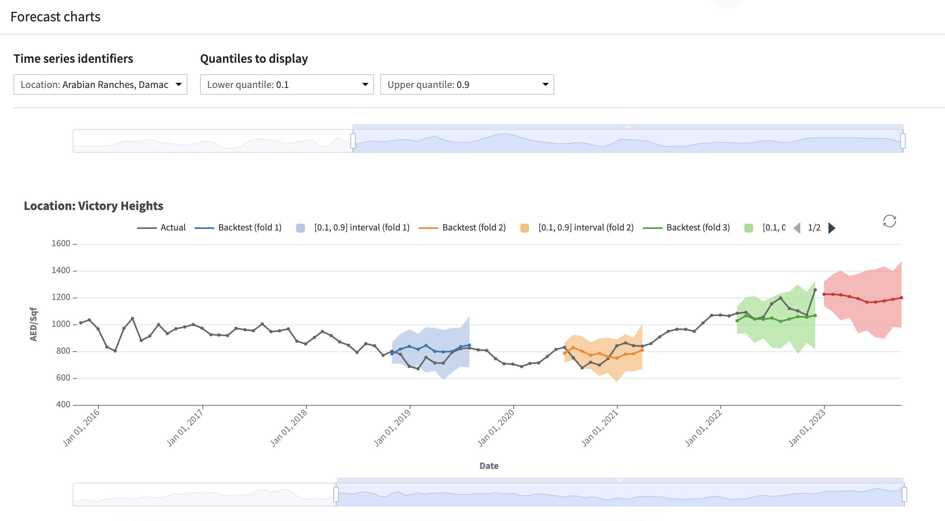
TIME SERIES ANALYSIS
Our data consist of all real estate transactions in Dubai for the last 15 years. We also added economic data such as the dollar index to track inflation, oil&gaz index, stock index …
Dubai real estate is separated in 3 main categories : apartments, villas and townhouses. Those are, most of the time, located in communities that are built and sold following phases.
After clustering the data with K-means, The Sustainable City is identified as a medium luxury community, with a target of foreign and young customers. TSC has mainly townhouses and villas, with a green and sustainable identity. 8 other communities are within the cluster and are similar and close to TSC.
We then analyzed our data by statistical tests, in particular : Durbin-Watson for autocorrelation, Kwiatkowski for non-stationarity, Zivot-Andrews for trend stationarity and Mann-Kendall for trend. Conclusions were that the only community of the cluster that follows an autocorrelated time series, non-flat, and having a highly increasing trend was The Sustainable City with almost as good results for Green Community West. The best performing time series model was neural networks scoring a 6% MAPE, a highly accurate forecasting according to literature. Below are displayed time series forecastings for the whole Dubai real estate market and for TSC as well as two comparative competitors. GCW and Victory Heights being the two communities with the most similar distribution in terms of Sqf and price per Sqf.
Dubai all market
Green Community West
The Sustainable City
Victory Heights

Slide 4
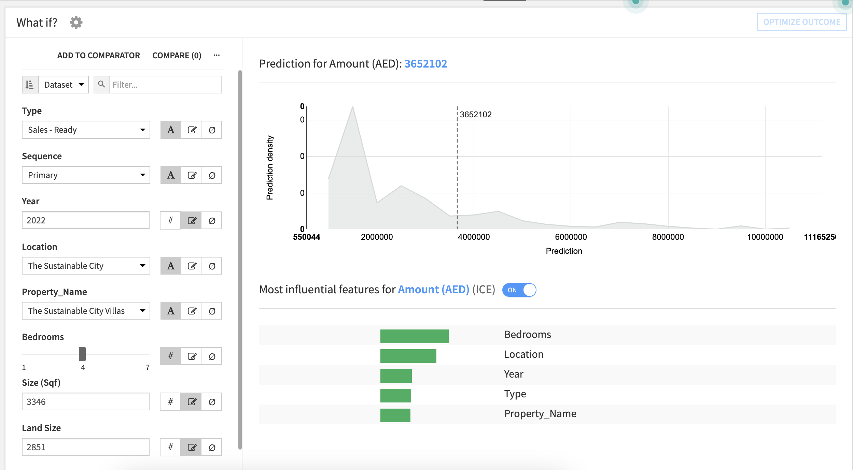
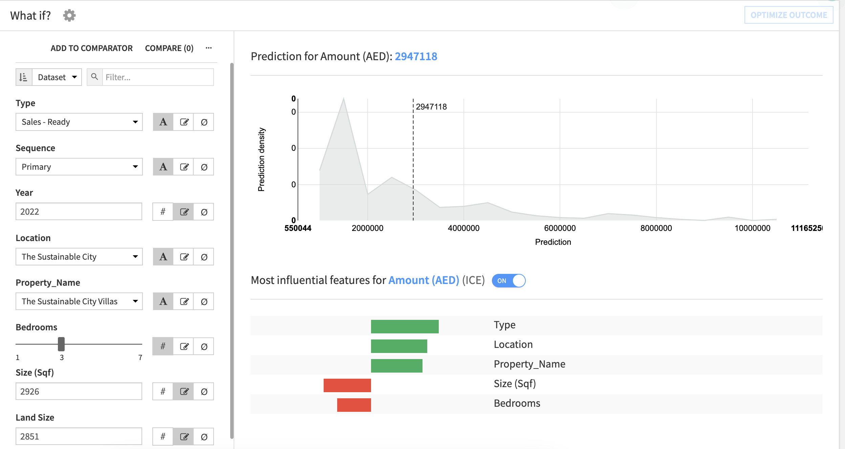
Price Estimation App
The web-app built in feature, allows the user to quicky evaluate the value of his asset or forecast it’s future value.
4 bedrooms in TSC
3 bedrooms in TSC
Optimization of gradient boosted trees with 247 trees of max depth 7 gave an R2 score of 0.9 and a MAPE of 15%.
Those results are highly positive and informative and constitute a satisfying POC. However, they need to be enriched with more exogenous and geospatial data in order to reduce the Mean Average Percentage Error.

Slide 5
MART SALES PREDICTIONS
Introduction
Asia
Europe
US
Africa
Middle East
Request
Shopping centers such as malls and marts are usually recording sales as an important step to predict the activity and get an idea about future demands that can help, for example, with inventory management. The objective of this project is to understand what role certain properties of an item play and how they affect their sales. The data is listing sales of 1559 different products from 10 stores in different cities.
Main challenges
With a missing values, data needs to be accurately cleaned to keep enough information while not adding noise.
Data quantity is also a barrier since we only have 8K rows, we will need to put effort to achieve satisfying scores, in order to give relevant insights to our client.
Create a precise model that would retain good interpretability
Middle East
Infomineo’s approach
Conducting desk research leveraging different types of sources (by order of priority):
To build a predictive model that can find out the sales of each product at a particular store and then provide actionable recommendations to the cie sales team to understand the properties of products and stores which play a key role in increasing sales.
Checking Africa-focused Development banks and financial institutions project documents as they provide financial and technical assistance to countries implementing such programs
Countries local press to find insights on programs achievements and bottlenecks
Deliverable
We built a predictive model that can find out the sales of each product at a particular store and then provide actionable recommendations to the client’s sales team, in order to understand the properties of products and stores which play a key role in increasing sales.

Slide 6
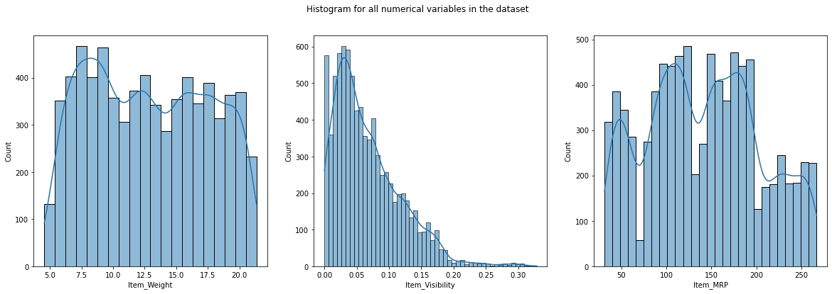
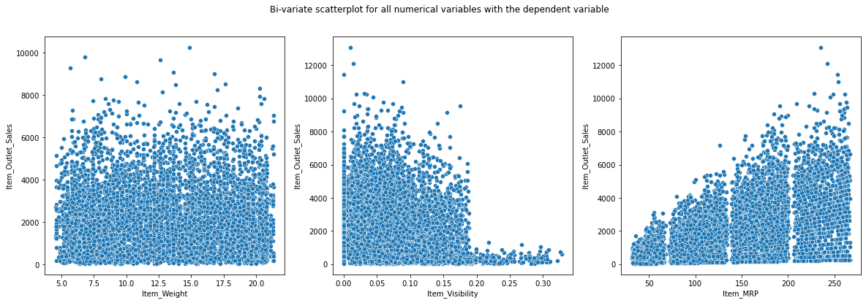
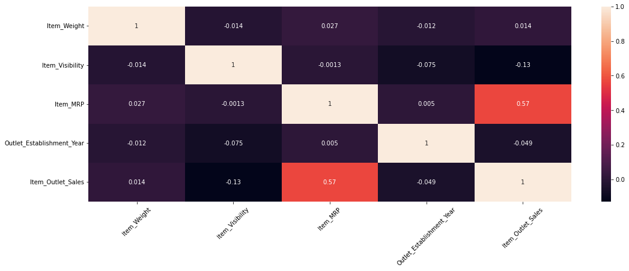
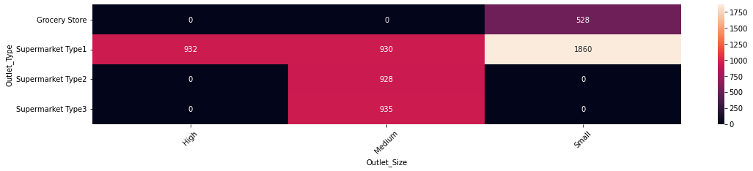
Analyzing and cleaning data
The training dataset we collected has 8523 observations and 10 columns. Item Weight and Outlet Size revealed substantial number of missing values, specifically outlet size that is a n important feature. After understanding the business problem, the next step to follow is to have a better understanding of the dataset, i.e., what is the distribution of the variables, what are different relationships that exist between variables, etc. We will also treat anomalies like missing values or outliers. Part of this analysis is available in the below graphs
Analyzing num. Variables
Bi-variate scatter plot
The variable Item_Weight is approx uniformly distributed and we will need to keep in mind when we will impute the missing values for this column, so we don't end up changing the distribution significantly after imputing. The variable Item_Visibility is a right-skewed distribution which means that there are more visible Items. The variable of products prices is following an approx multi-modal normal distribution.
The first scatter plot shows the data is completely random and there is no relationship between Item Weight and target. The second scatter plot between Item Visibility and target shows some kind of pattern, as the Item Visibility increases from 0.19, the sales decrease. This might be due to the management giving more visibility to those items which are not generally sold often. The third scatter plot is between the variables - Item_MRP and target. The variable Item_MRP will have a good predictive power to predict the sales.
Bi-variate Analysis for num. variables
Bi-variate analysis for cat. variables
We observe from the above heatmap that all the grocery stores have Outlet_Size as small.
All the Supermarket Type 2 and Supermarket Type 3 have Outlet_Size as Medium. This informations are used to impute missing values for Outlet_Size.
it seems that only the independent variable Item_MRP has a moderate linear relationship with the target Item_Outlet_Sales.
There is no co-linearity between features.

Slide 7
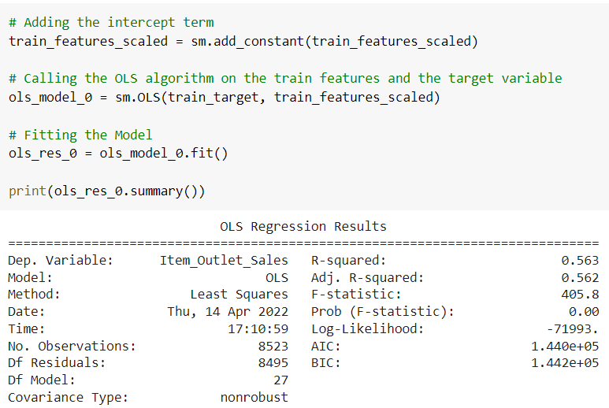
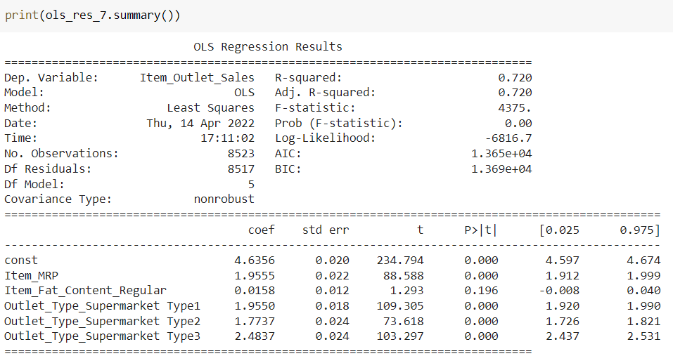
Modelling linear regression
During the modelling analysis, it is crucial to remove multi-collinearity and to keep only the relevant features. Linear regressions also need to satisfy four major assumptions that we will study to have the most accurate mathematical model.
Baseline regression model
Final regression model
Through multiple iterations, we removed multicollinearity of features using Variance Inflation Factor and removed low importance features with P-values.
We then checked the four different assumptions of linear regression and fixed the model iteratively:
Mean of residuals should be 0
Normality of error terms
Linearity of variables
No heteroscedasticity
Final model equation has been computed and given bellow :

Slide 8
McKinsey South Africa Office
Understanding the key success factors of Least Developed Countries graduation journey as per the UN Committee for Development Policy requirements (1/2)
Asia
Europe
US
Africa
Middle East
Request
We would like to know from the LDC (Least Developed Countries) that have graduated or will graduate, what are the key success factors of their graduation journey ? What specific actions have governments done ?
The countries we want to focus on are: Botswana, Cape Verde and Equatorial Guinea.
Main challenges
Time spending limit (3 hours): we needed to understand first the principles of the graduation journey and then find insights specific to the governments' actions that have led to their graduation
As the government actions are not necessarily implemented for the specific purpose of the graduation journey (which is more a consequence of economic and human development and good governance initiatives), we proceeded with a “guess and check” approach looking into governments’ successful policies that might have directly or indirectly led to their graduation journey
Middle East
Infomineo’s approach
Mainly leveraging reports of specific UN agencies focusing on the topic: the United Nations Department of Economic and Social Affairs, the United Nations Conference on Trade and Development.
Research in local official sources leveraging our Portuguese and Spanish capabilities to find more information on Cape Verde and Guinea Equatorial
Deliverable
Excel deliverable with detailed insights on the requested dimensions. (Screenshot of the deliverable in the next slide)

Slide 9
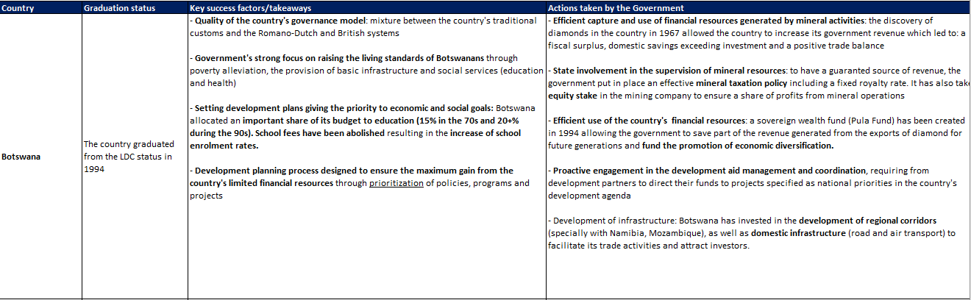
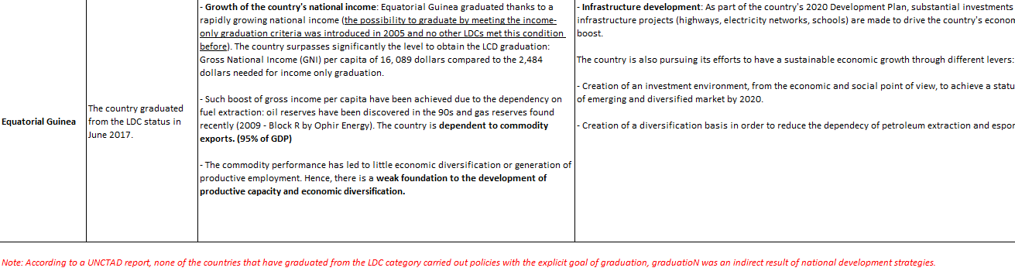
McKinsey South Africa Office
Understanding the key success factors of Least Developed Countries graduation journey as per the UN Committee for Development Policy requirements (2/2)

Slide 10
McKinsey South Africa Office
Providing best practice case examples of public sector reforms in Sudan, Kenya and Ghana (1/2)
Asia
Europe
US
Africa
Middle East
Request
We are working on a civil service transformation reform, and need your support with best practice case examples of public sector reforms in Sudan, Kenya and Ghana. We specifically need country context data (population, size of civil service, federal state, etc.), description of the initial situation, reform approach with specific examples, impact of the initiatives
Main challenges
Research was not insightful for Sudan as we could not find enough material on public sector reforms thus we suggested the requestor to focus on another country
Lack of quantitative data regarding the outcome of the implemented public sector reforms initiatives, we could only rely on examples presented by the governments and international institutions (United Nations Public Administration Network) as successful cases
Middle East
Infomineo’s approach
Conducting desk research leveraging different types of sources prioritizing the below:
The specified countries’ ministries in charge of Public sector reforms (Ghanaian Office of Civil Service, Kenyan Public Service Commission)
The National institutes of Public administration which generally publish papers on the public sector reforms initiatives
Regional sources involved in public sector reforms : Economic Commission for Africa
United Nations Public Administration Network focusing on the promotion of better public administration
Deliverable
PPT deliverable with detailed insights on the requested dimensions. (Screenshot of the deliverable in the next slide)
Sharing detailed reports on the topic with the consulting team after selecting the most relevant insights specific to the countries of focus (e.g. “Innovations and Best Practices in public sector reforms – Cases of Civil Service in Ghana, Kenya, Nigeria, and South Africa”, Economic Commission for Africa, December 2010)

Slide 11
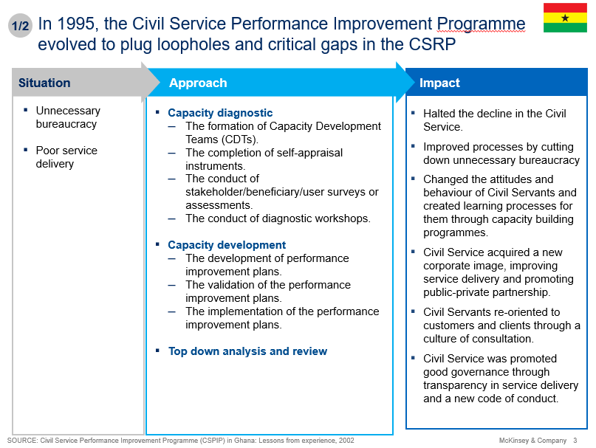
McKinsey South Africa Office
Providing best practice case examples of public sector reforms in Sudan, Kenya and Ghana (2/2)

Slide 12
McKinsey Paris Office
Xxxx (1/2)
Asia
Europe
US
Africa
Middle East
Request
We are working on a civil service transformation reform, and need your support with best practice case examples of public sector reforms in Sudan, Kenya and Ghana. We specifically need country context data (population, size of civil service, federal state, etc.), description of the initial situation, reform approach with specific examples, impact of the initiatives
Main challenges
Research was not insightful for Sudan as we could not find enough material on public sector reforms thus we suggested the requestor to focus on another country
Lack of quantitative data regarding the outcome of the implemented public sector reforms initiatives, we could only rely on examples presented by the governments and international institutions (United Nations Public Administration Network) as successful cases
Middle East
Infomineo’s approach
Conducting desk research leveraging different types of sources prioritizing the below:
The specified countries’ ministries in charge of Public sector reforms (Ghanaian Office of Civil Service, Kenyan Public Service Commission)
The National institutes of Public administration which generally publish papers on the public sector reforms initiatives
Regional sources involved in public sector reforms : Economic Commission for Africa
United Nations Public Administration Network focusing on the promotion of better public administration
Deliverable
PPT deliverable with detailed insights on the requested dimensions. (Screenshot of the deliverable in the next slide)
Sharing detailed reports on the topic with the consulting team after selecting the most relevant insights specific to the countries of focus (e.g. “Innovations and Best Practices in public sector reforms – Cases of Civil Service in Ghana, Kenya, Nigeria, and South Africa”, Economic Commission for Africa, December 2010)

Slide 13
McKinsey South Africa Office
Providing best practice case examples of public sector reforms in Sudan, Kenya and Ghana (1/2)
Asia
Europe
US
Africa
Middle East
Request
We are working on a civil service transformation reform, and need your support with best practice case examples of public sector reforms in Sudan, Kenya and Ghana. We specifically need country context data (population, size of civil service, federal state, etc.), description of the initial situation, reform approach with specific examples, impact of the initiatives
Main challenges
Research was not insightful for Sudan as we could not find enough material on public sector reforms thus we suggested the requestor to focus on another country
Lack of quantitative data regarding the outcome of the implemented public sector reforms initiatives, we could only rely on examples presented by the governments and international institutions (United Nations Public Administration Network) as successful cases
Middle East
Infomineo’s approach
Conducting desk research leveraging different types of sources prioritizing the below:
The specified countries’ ministries in charge of Public sector reforms (Ghanaian Office of Civil Service, Kenyan Public Service Commission)
The National institutes of Public administration which generally publish papers on the public sector reforms initiatives
Regional sources involved in public sector reforms : Economic Commission for Africa
United Nations Public Administration Network focusing on the promotion of better public administration
Deliverable
PPT deliverable with detailed insights on the requested dimensions. (Screenshot of the deliverable in the next slide)
Sharing detailed reports on the topic with the consulting team after selecting the most relevant insights specific to the countries of focus (e.g. “Innovations and Best Practices in public sector reforms – Cases of Civil Service in Ghana, Kenya, Nigeria, and South Africa”, Economic Commission for Africa, December 2010)

Slide 14
McKinsey South Africa Office
Providing best practice case examples of public sector reforms in Sudan, Kenya and Ghana (2/2)

